Slide 1
Deep Learning

Slide 2
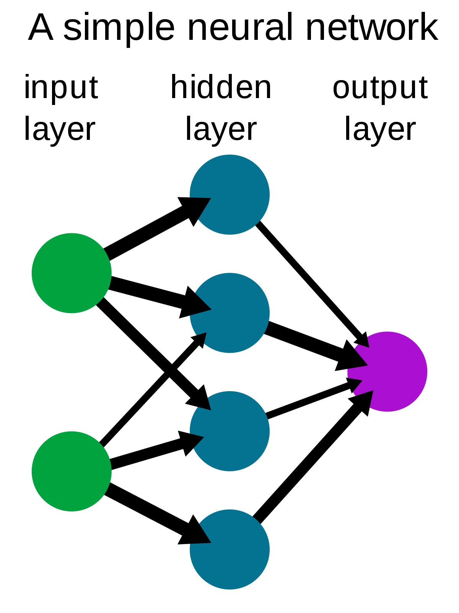
A Simple Neural Network

Slide 3
Types of Neural Networks
Feedforward neural network, or multi-layer perceptrons:
They are comprised of an input layer, a hidden layer or layers, and an output layer. While these neural networks are also commonly referred to as MLPs, it’s important to note that they are actually comprised of sigmoid neurons, not perceptrons, as most real-world problems are nonlinear. Data usually is fed into these models to train them, and they are the foundation for computer vision, natural language processing, and other neural networks.
Convolutional neural networks (CNNs):
CNNs are similar to feedforward networks, but they’re usually utilized for image recognition, pattern recognition, and/or computer vision. These networks harness principles from linear algebra, particularly matrix multiplication, to identify patterns within an image.
Recurrent neural networks (RNNs):
RNNs are identified by their feedback loops. These learning algorithms are primarily leveraged when using time-series data to make predictions about future outcomes, such as stock market predictions or sales forecasting.

Slide 4
How do neural networks work?
Think of each individual node as its own linear regression model, composed of input data, weights, a bias (or threshold), and an output.
Once an input layer is determined, weights are assigned. These weights help determine the importance of any given variable, with larger ones contributing more significantly to the output compared to other inputs.
All inputs are then multiplied by their respective weights and then summed. Afterward, the output is passed through an activation function, which determines the output. If that output exceeds a given threshold, it “fires” (or activates) the node, passing data to the next layer in the network.
This results in the output of one node becoming in the input of the next node. This process of passing data from one layer to the next layer defines this neural network as a feedforward network.

Slide 5
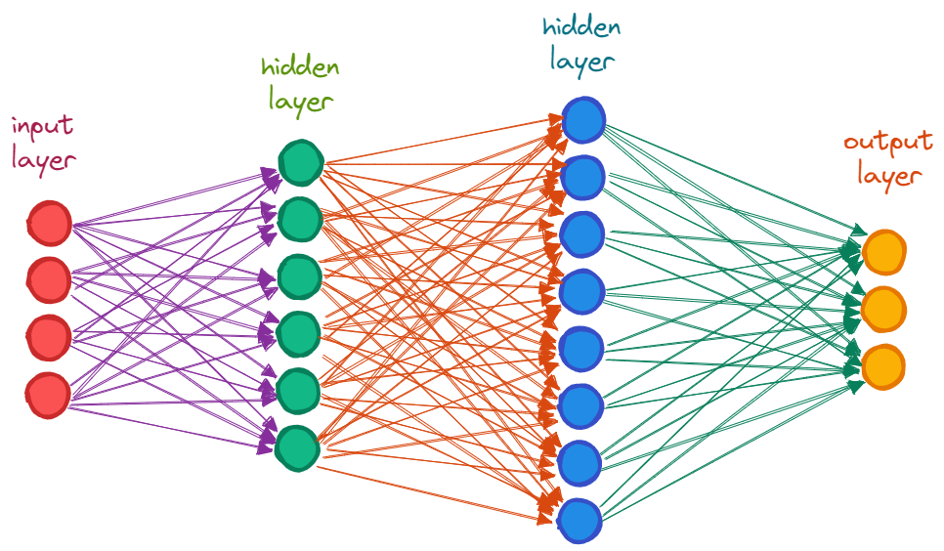

Slide 6
Simple neural network architecture
A basic neural network has interconnected artificial neurons in three layers:
Information from the outside world enters the artificial neural network from the input layer. Input nodes process the data, analyze or categorize it, and pass it on to the next layer.
Input Layer
Information from the outside world enters the artificial neural network from the input layer. Input nodes process the data, analyze or categorize it, and pass it on to the next layer.
Hidden Layer
Hidden layers take their input from the input layer or other hidden layers. Artificial neural networks can have a large number of hidden layers. Each hidden layer analyzes the output from the previous layer, processes it further, and passes it on to the next layer.
Output Layer
The output layer gives the final result of all the data processing by the artificial neural network. It can have single or multiple nodes. For instance, if we have a binary (yes/no) classification problem, the output layer will have one output node, which will give the result as 1 or 0. However, if we have a multi-class classification problem, the output layer might consist of more than one output node.

Slide 7
Simple neural network architecture
Deep neural network architecture
Deep neural networks, or deep learning networks, have several hidden layers with millions of artificial neurons linked together. A number, called weight, represents the connections between one node and another. The weight is a positive number if one node excites another, or negative if one node suppresses the other. Nodes with higher weight values have more influence on the other nodes.
Theoretically, deep neural networks can map any input type to any output type. However, they also need much more training as compared to other machine learning methods. They need millions of examples of training data rather than perhaps the hundreds or thousands that a simpler network might need.

Slide 8
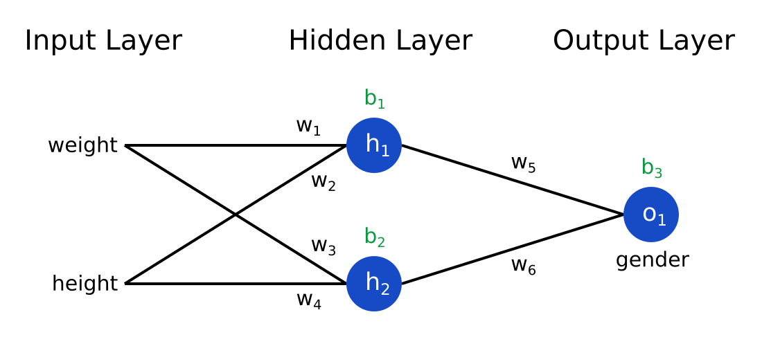

Slide 9
How to train neural networks?
Neural network training is the process of teaching a neural network to perform a task. Neural networks learn by initially processing several large sets of labeled or unlabeled data. By using these examples, they can then process unknown inputs more accurately.
Supervised learning
In supervised learning, data scientists give artificial neural networks labeled datasets that provide the right answer in advance. For example, a deep learning network training in facial recognition initially processes hundreds of thousands of images of human faces, with various terms related to ethnic origin, country, or emotion describing each image.
The neural network slowly builds knowledge from these datasets, which provide the right answer in advance. After the network has been trained, it starts making guesses about the ethnic origin or emotion of a new image of a human face that it has never processed before.

Slide 10
Multi-Layer Perceptron
MLP stands for Multilayer Perceptron, which is a type of artificial neural network (ANN) consisting of multiple layers of interconnected nodes, or neurons. MLPs are widely used in machine learning and are particularly effective for supervised learning tasks, such as classification and regression.
Each neuron in an MLP receives input from the neurons in the previous layer, processes that input using a non-linear activation function, and produces an output that is sent to the neurons in the next layer. The neurons in the hidden layers of an MLP apply transformations to the input data to create a more complex representation of the data, which is then used by the output layer to make a prediction or classification.
MLPs are trained using a process called backpropagation, in which the network learns to adjust the weights and biases of its neurons to minimize the error between its predictions and the true values. This is done by computing the gradient of the error with respect to each weight and bias, and using that gradient to update the weights and biases in the direction that reduces the error.

Slide 11
Multi-Layer Perceptron

Slide 12
Recurrent Neural Networks
RNN stands for Recurrent Neural Network, which is a type of artificial neural network designed to process sequential data. Unlike traditional feedforward neural networks, which process fixed-length inputs independently of each other, RNNs can process inputs of variable length and use their internal state to remember information from previous inputs.
RNNs achieve this by introducing loops in the network architecture that allow information to be passed from one time step to the next. At each time step, the network takes an input vector and uses it, together with its internal state, to compute an output vector and update its internal state. The output vector can be used to make a prediction or classification, and the updated state is then passed on to the next time step.
The ability of RNNs to process sequential data makes them well-suited for tasks such as natural language processing, speech recognition, and time-series prediction. However, standard RNNs can suffer from the vanishing gradient problem, where the gradient of the loss function with respect to the network parameters becomes very small and the network is unable to learn long-term dependencies.
To address this problem, variants of RNNs such as Long Short-Term Memory (LSTM) and Gated Recurrent Unit (GRU) have been developed. These models use specialized units that allow them to selectively forget or remember information from previous time steps, making them more effective at learning long-term dependencies in sequential data.

Slide 13
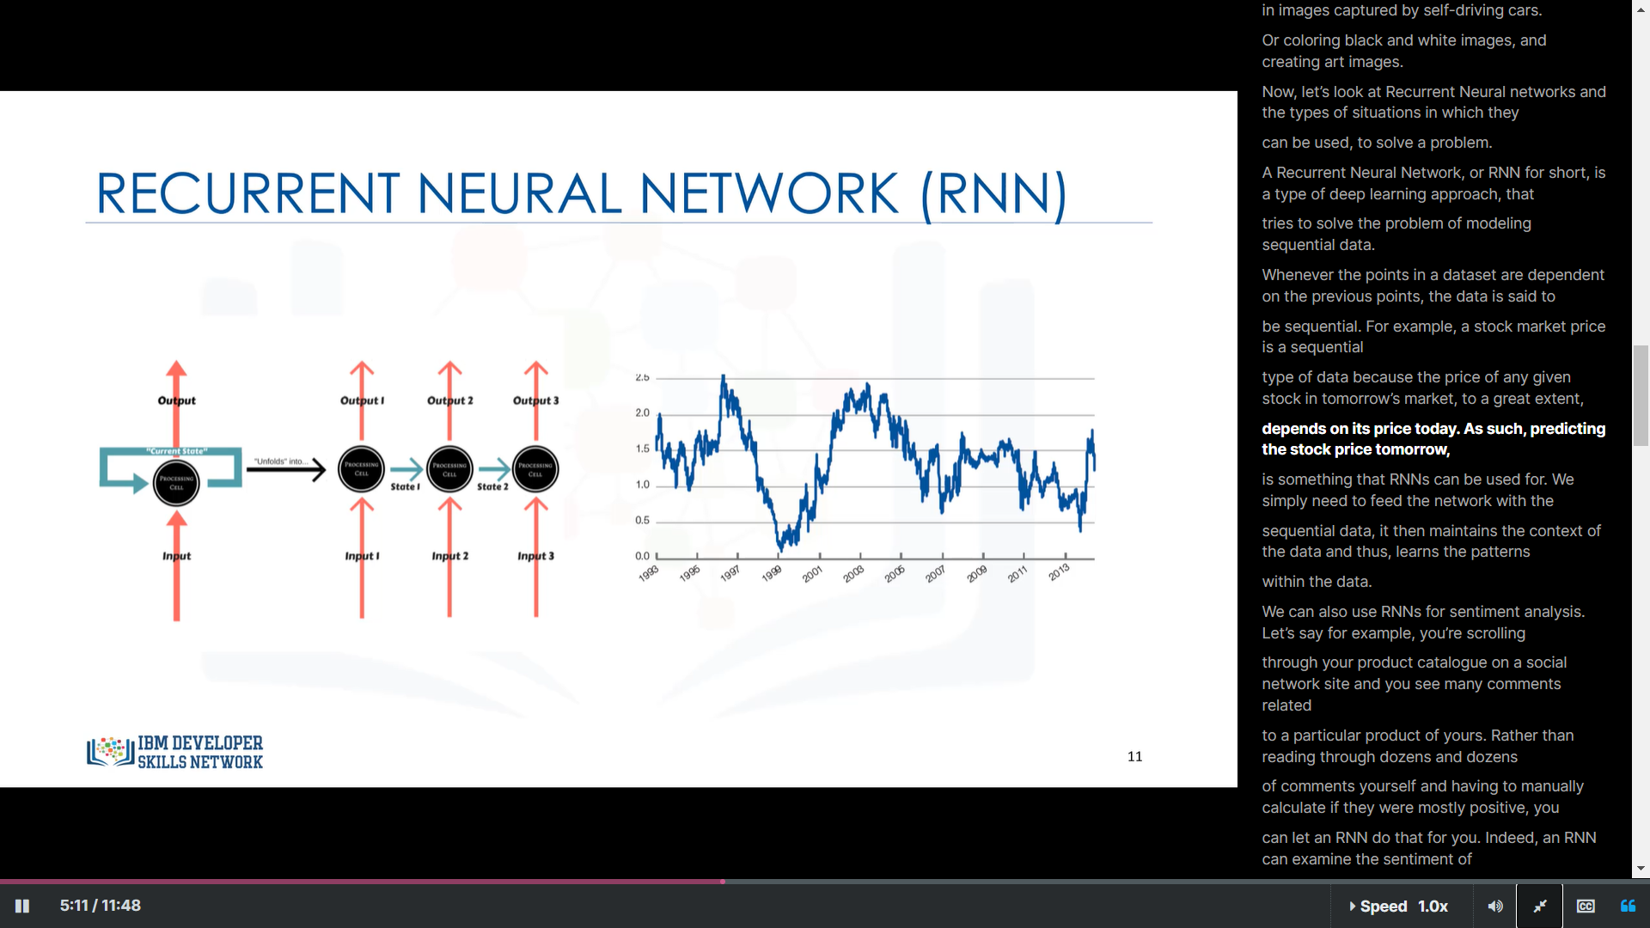

Slide 14
Convolutional Neural Networks
Convolutional Neural Networks (CNNs) are a type of neural network that is particularly effective for image and video recognition, classification, and analysis. They are designed to automatically detect and learn features within image data, by applying a series of convolutional and pooling layers.
The convolutional layers perform a series of convolutions on the input image, using filters or kernels that slide over the image to extract specific features, such as edges, corners, or textures. The output of each convolutional layer is passed through a non-linear activation function, such as ReLU (Rectified Linear Unit), to introduce non-linearity into the network.
The pooling layers reduce the spatial size of the output from the convolutional layers, by down-sampling the feature maps. This helps to reduce the dimensionality of the data, while preserving the important features. The most common type of pooling operation is max-pooling, which selects the maximum value within each pooling window.

Slide 15
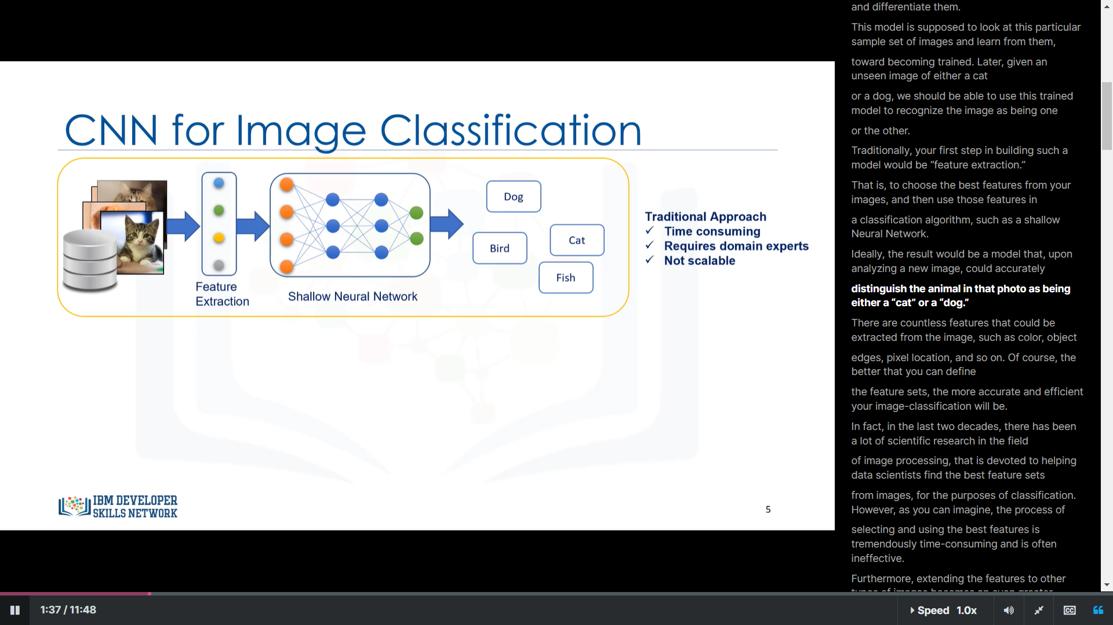

Slide 16
Convolutional Neural Networks
CNNs can also include fully connected layers, which combine the features extracted by the convolutional layers and perform classification or regression on the input data. The output of the last fully connected layer is usually fed into a softmax layer, which produces a probability distribution over the possible classes.
CNNs are trained using a variant of backpropagation called backpropagation through convolutional layers (backpropagation through convolution or BP-CNN), which allows the network to learn the appropriate filter values for each convolutional layer. This process involves computing the gradient of the loss function with respect to the filter values and updating them in the direction that reduces the error.
CNNs have achieved state-of-the-art performance on a wide range of image and video recognition tasks, including object detection, image segmentation, and facial recognition. They have also been applied to other domains, such as natural language processing and speech recognition, with promising results.

Slide 17
Libraries being used:
Tensorflow
Pandas
Matplotlib
Numpy
Keras
And more

Slide 18
Dynamic Control Flow
In TensorFlow, dynamic control flow refers to the ability to create operations whose behavior depends on the values of tensors at runtime. This is in contrast to static control flow, where the control flow graph (CFG) is fixed at graph construction time and cannot be changed at runtime.
With dynamic control flow, TensorFlow allows for more flexible and expressive models, where different parts of the computation graph can be executed based on the values of input tensors. This is particularly useful for tasks such as sequence modeling, where the length of the input sequences may vary from one example to another.

Slide 19
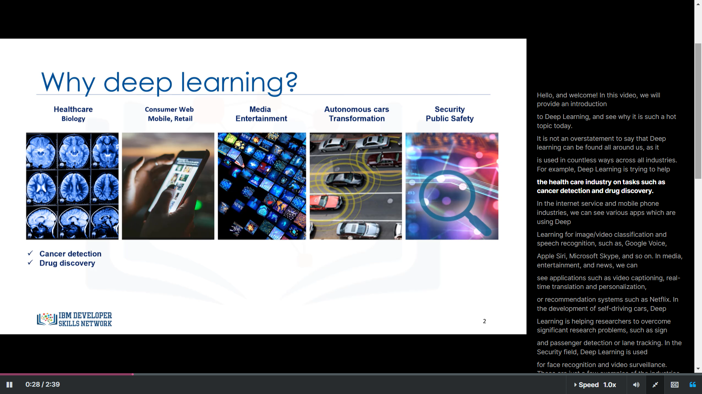
Why deep learning?

Slide 20
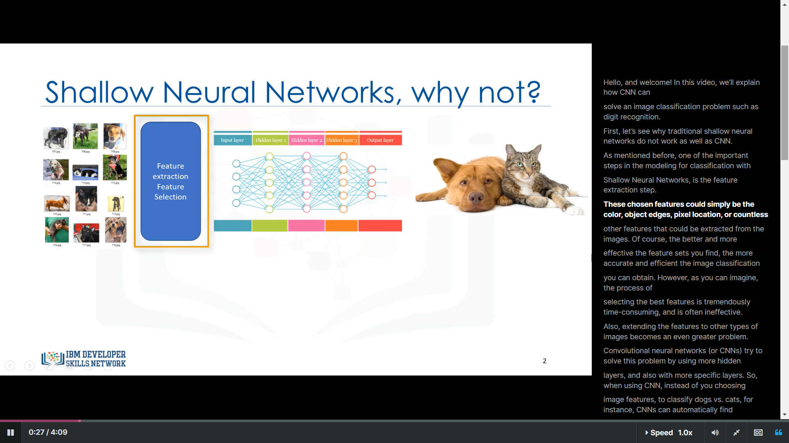

Slide 21
Autoencoder
Basically, an autoencoder decodes an input, let us consider image as our input, and decodes it.
The decodes data is then is then processed in a neural network.
The neural network again tries to build back the same image by using the decoded data.
This entire process takes place in a neural network.
This is what an autoencoder does.

Slide 22
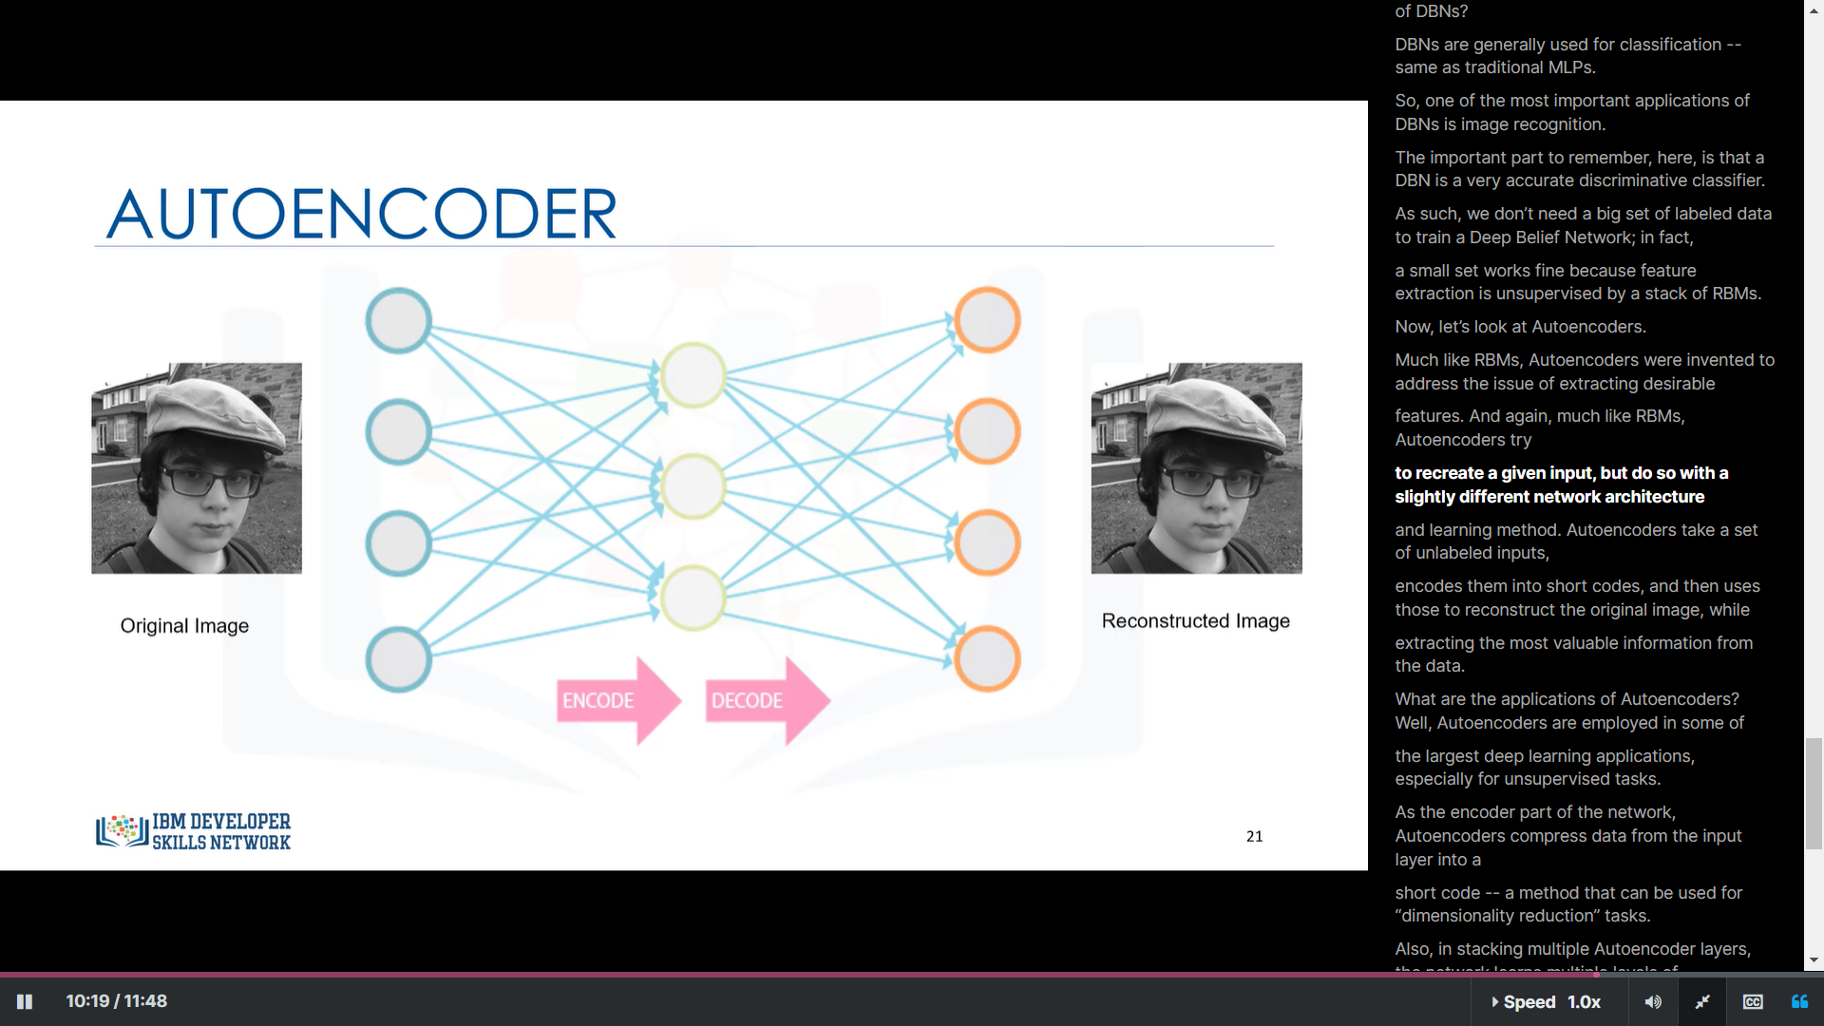

Slide 23
Language Modelling

Slide 24
Language Modelling:
Language Modelling, to put it simply, is the task of assigning probabilities to sequences of words. This means that, given a context of one or a sequence of words in the language the model was trained on, the model should provide the next most probable words or sequence of words that follows from the given sequence of words the sentence. Language Modelling is one of the most important tasks in Natural Language Processing.

Slide 25
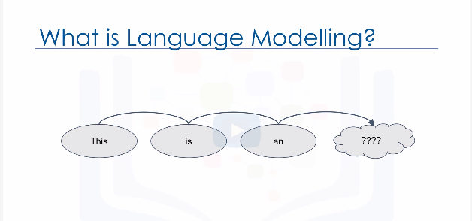

Slide 26
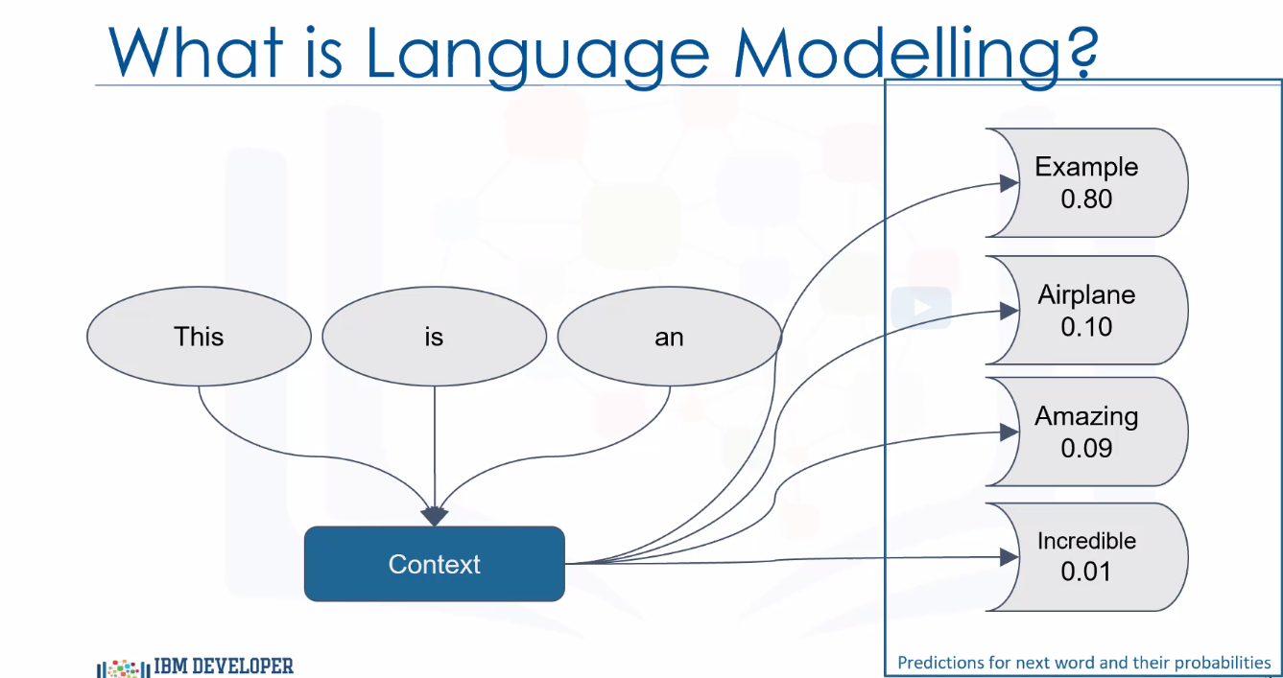

Slide 27
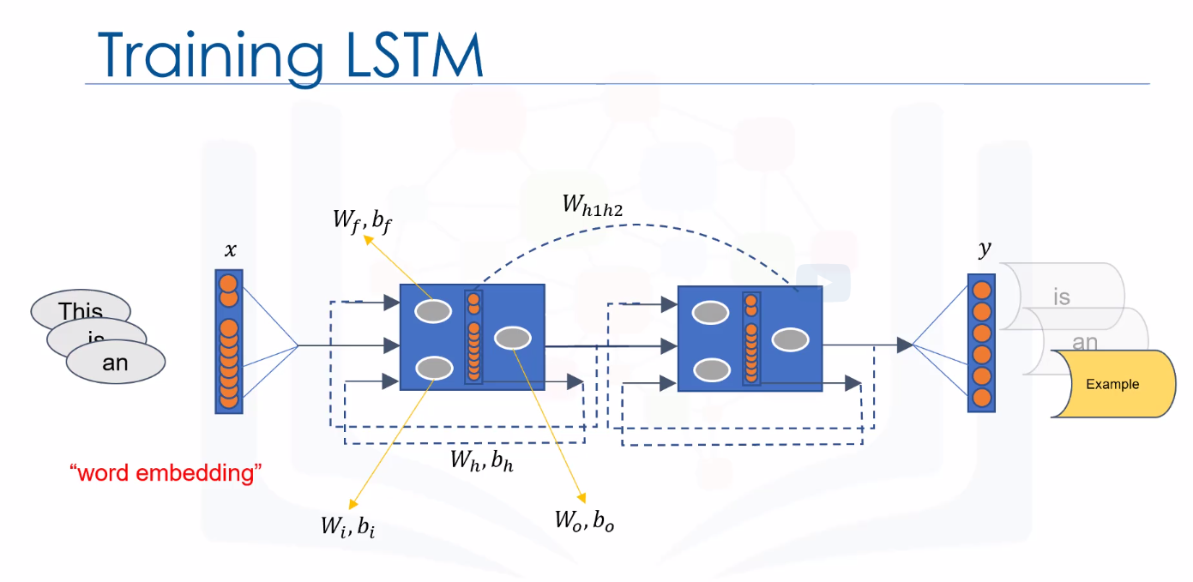

Slide 28
Perplexity:
Perplexity is a metric commonly used in language modeling to evaluate the performance of a probabilistic model, such as a language model. It provides a quantitative measure of how well the model predicts a given sample or sequence of words.
In general, perplexity measures how surprised or confused the model is when trying to predict the next word in a sequence. A lower perplexity indicates that the model is more certain and accurate in its predictions, whereas a higher perplexity suggests that the model is less confident and less accurate.
To understand the concept of perplexity, imagine you have a language model trained on a large dataset of sentences. When you provide the model with a test set of sentences, it tries to predict the next word for each sentence. The perplexity score is then calculated based on how well the model's predictions align with the actual next words in the test set.

Slide 29
Perplexity:
A lower perplexity value indicates that the model is more confident and has a better understanding of the language patterns present in the data. It implies that the model is better at predicting the next word given the context of the previous words. On the other hand, a higher perplexity suggests that the model struggles to make accurate predictions, possibly due to insufficient training data or limitations in the model architecture.
In practice, researchers and practitioners aim to minimize perplexity when training language models because it corresponds to better predictive performance. A lower perplexity means that the model's predictions align more closely with the ground truth, indicating a higher degree of trust in the model's output.
However, it's worth noting that perplexity is just one of many evaluation metrics used in language modeling, and it is not the only measure of a model's quality. Other factors such as semantic coherence, diversity of generated text, and real-world usefulness also need to be considered when assessing the overall effectiveness of a language model.

Slide 30
Word Embedding:
For better processing, in this example, we will make use of word embeddings, which is a way of representing sentence structures or words as n-dimensional vectors (where n is a reasonably high number, such as 200 or 500) of real numbers. Basically, we will assign each word a randomly-initialized vector, and input those into the network to be processed. After a number of iterations, these vectors are expected to assume values that help the network to correctly predict what it needs to -- in our case, the probable next word in the sentence. This is shown to be a very effective task in Natural Language Processing, and is a commonplace practice.
𝑉𝑒𝑐("𝐸𝑥𝑎𝑚𝑝𝑙𝑒")=[0.02,0.00,0.00,0.92,0.30,…]

Slide 31
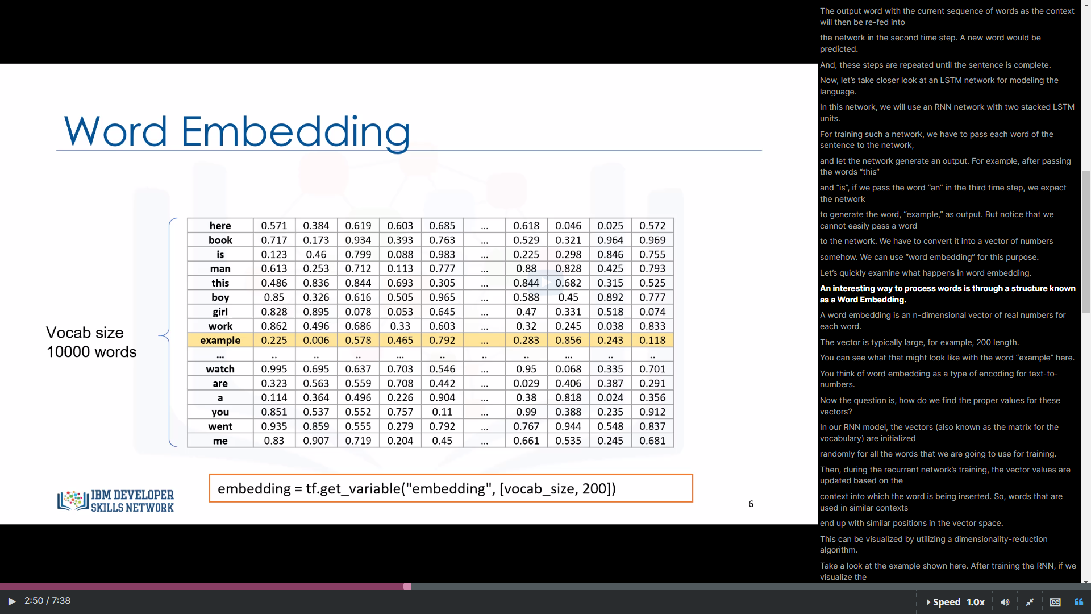

Slide 32
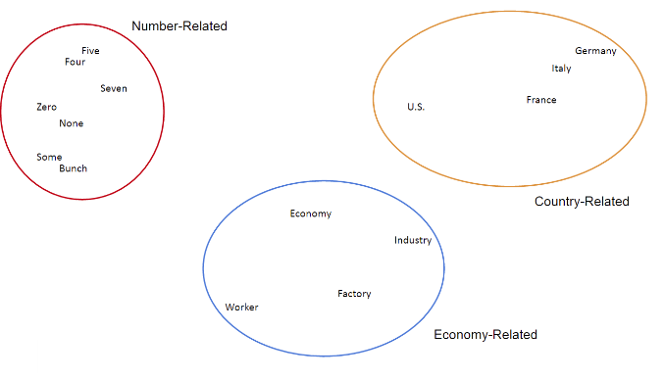
Word Embedding:
Word Embedding tends to group up similarly used words reasonably close together in the vectorial space. For example, if we use T-SNE (a dimensional reduction visualization algorithm) to flatten the dimensions of our vectors into a 2-dimensional space and plot these words in a 2-dimensional space, we might see something like this:

Slide 33
Word Embedding:
As you can see, words that are frequently used together, in place of each other, or in the same places as them tend to be grouped together -- being closer together the higher they are correlated. For example, "None" is pretty semantically close to "Zero", while a phrase that uses "Italy", you could probably also fit "Germany" in it, with little damage to the sentence structure. The vectorial "closeness" for similar words like this is a great indicator of a well-built model.
We need to import the necessary modules for our code. We need numpy and tensorflow, obviously. Additionally, we can import directly the tensorflow.models.rnn model, which includes the function for building RNNs, and tensorflow.models.rnn.ptb.reader which is the helper module for getting the input data from the dataset we just downloaded.

Slide 34
Network Structure:
In this network, the number of LSTM cells are 2. To give the model more expressive power, we can add multiple layers of LSTMs to process the data. The output of the first layer will become the input of the second and so on.
The recurrence steps is 20, that is, when our RNN is "Unfolded", the recurrence step is 20.
the structure is like:
200 input units -> [200x200] Weight -> 200 Hidden units (first layer) -> [200x200] Weight matrix -> 200 Hidden units (second layer) -> [200] weight Matrix -> 200 unit output

Slide 35
Embeddings
In deep learning, embeddings refer to a technique that represents high-dimensional data in a lower-dimensional space. Embeddings are commonly used to capture and encode semantic relationships between entities or features in a more compact and meaningful representation. They are particularly useful for tasks such as natural language processing (NLP), computer vision, and recommendation systems.
Let's take the example of word embeddings in NLP. Words in a text are typically represented as discrete symbols or one-hot vectors, where each word is assigned a unique index. However, these representations do not capture any semantic information or relationships between words. Word embeddings, on the other hand, represent words as dense, low-dimensional vectors in which similar words are closer together in the vector space.

Slide 36
Word embeddings are learned from large amounts of text data using models like Word2Vec, GloVe, or FastText. These models leverage the context of words in sentences to learn the embeddings. For example, the word "king" might be represented by a vector that is closer to "queen" than to "cat" in the embedding space, capturing the notion of gender and royalty.
Embeddings can also be learned for other types of data, such as images or user preferences. In computer vision, for instance, convolutional neural networks (CNNs) can learn image embeddings that capture visual features of objects or scenes. Similarly, in recommendation systems, embeddings can be used to represent users and items, allowing for efficient similarity calculations or personalized recommendations.
Once the embeddings are learned, they can be used as input features for various downstream tasks. For instance, in NLP, word embeddings can be fed into a recurrent neural network (RNN) or a transformer model for tasks like sentiment analysis, machine translation, or text classification. The lower-dimensional representation provided by embeddings helps reduce the dimensionality of the input space and often leads to improved performance in these tasks.
Overall, embeddings are a powerful technique in deep learning that allows for the efficient representation and manipulation of high-dimensional data, capturing meaningful relationships and facilitating downstream tasks in various domains.

Slide 37
Purpose of Embeddings using word2vec
We have to convert the words in our dataset to vectors of numbers. The traditional approach is to use one-hot encoding method that is usually used for converting categorical values to numerical values. However, One-hot encoded vectors are high-dimensional, sparse and in a big dataset, computationally inefficient. So, we use word2vec approach. It is, in fact, a layer in our LSTM network, where the word IDs will be represented as a dense representation before feeding to the LSTM.The embedded vectors also get updated during the training process of the deep neural network. We create the embeddings for our input data. embedding_vocab is matrix of [10000x200] for all 10000 unique words.

Slide 38
The c_state and m_state in RNNs
In the context of deep learning and specifically recurrent neural networks (RNNs), such as LSTM (Long Short-Term Memory) and GRU (Gated Recurrent Unit), the "c state" and "m state" refer to the internal states of the RNN cells.
1. **C State (Cell State)**: The "c state" stands for the cell state, also known as the memory state or the long-term memory. It represents the memory of the LSTM or GRU cell and is responsible for retaining information over long sequences. The cell state serves as a memory cell that allows the network to remember or forget information selectively. The c state is updated by various gates in the LSTM or GRU architecture, such as the forget gate, input gate, and output gate, which control the flow of information in and out of the cell.
2. **M State (Hidden State)**: The "m state" refers to the hidden state or the short-term memory of the LSTM or GRU cell. It represents the current information that the cell considers important to propagate to the next time step. The hidden state is the output of the LSTM or GRU cell and carries the summarized information learned from the input sequence up to the current time step. The m state is updated based on the cell state and is influenced by various gates and activation functions in the RNN cell.
Both the c state and m state play crucial roles in capturing and retaining information in RNNs, allowing them to model sequential dependencies effectively. The c state provides a long-term memory capacity, while the m state captures the short-term dependencies in the input sequence. These states are updated and passed along from one time step to the next during the forward pass of the RNN.

Slide 39
CNNs
Two main concepts in CNNs are:
Convolutions
Max Pooling

Slide 40
Convolutions
Convolutions in Convolutional Neural Networks (CNNs) are a fundamental operation used to extract meaningful features from input data, such as images or sequences. CNNs are widely used in computer vision tasks, including image classification, object detection, and image segmentation.
A convolution is a mathematical operation that combines two functions to produce a third function. In the context of CNNs, convolutions are used to apply filters or kernels to input data. These filters are small matrices or tensors, typically with dimensions much smaller than the input data. The purpose of convolutions is to detect specific patterns or features within the input.

Slide 41
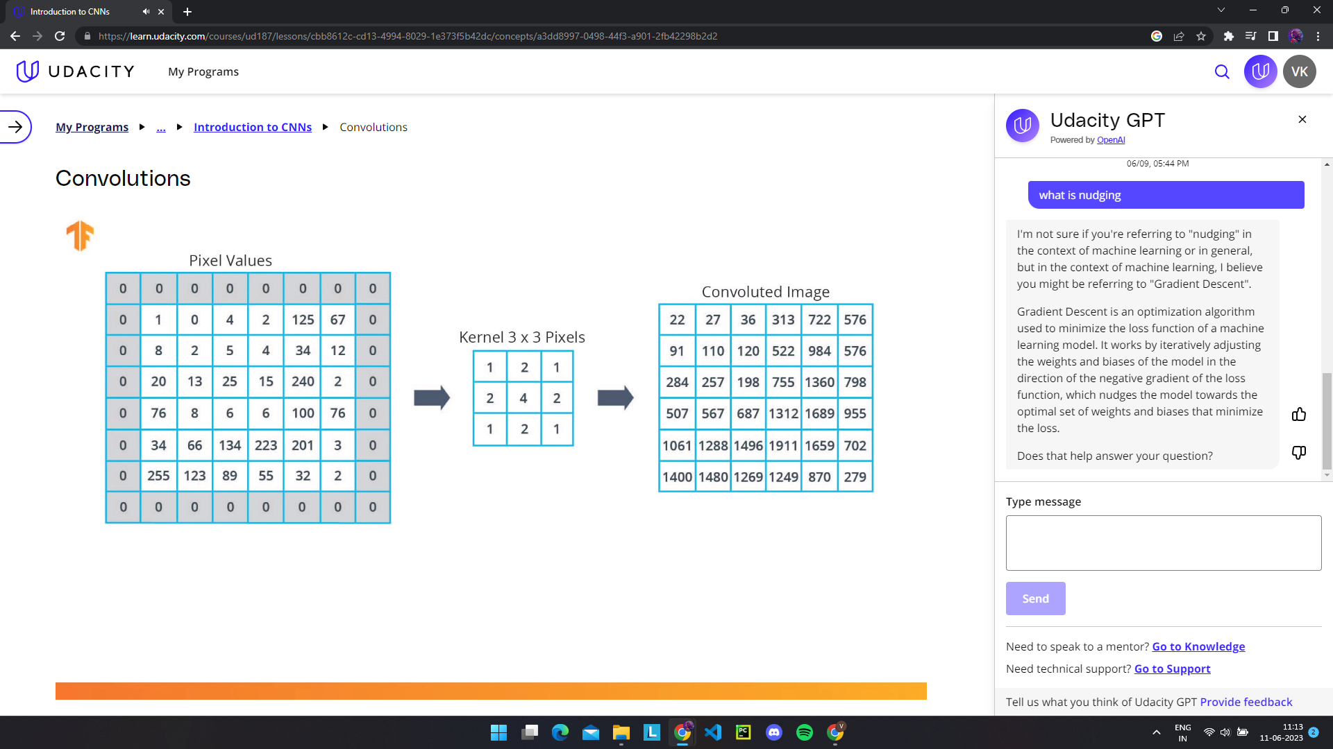

Slide 42
MaxPooling
Maxpooling is a common operation used in Convolutional Neural Networks (CNNs) to downsample the spatial dimensions of feature maps. It helps reduce the computational complexity of the network and provides some degree of translation invariance.
Maxpooling operates on a sliding window or kernel that moves across the input feature map in a non-overlapping manner. At each location, it selects the maximum value within the window and discards the rest. The output of maxpooling is a downsampled version of the input, where each value represents the maximum value within a specific region.

Slide 43
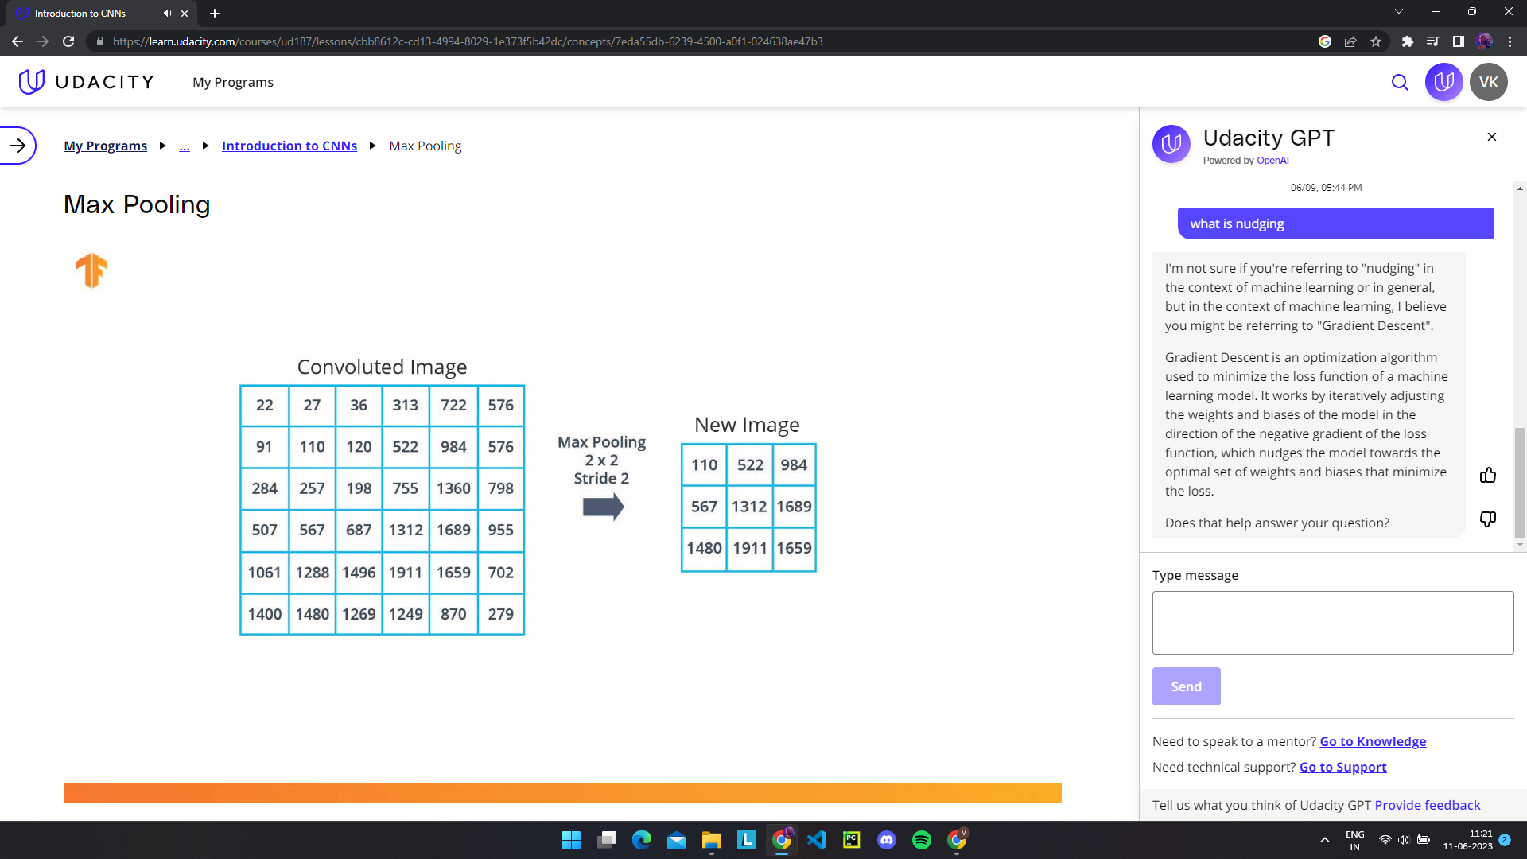

Slide 44
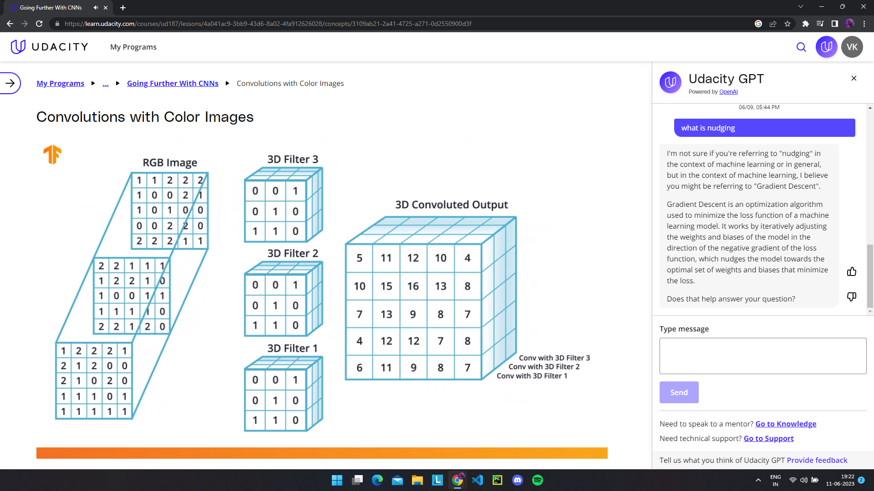

Slide 45
Colab Notebook Links
https://colab.research.google.com/drive/1MaOklGBV03UY6H4SDi7nTIfn7g47AXm(Image Classification for Convolution Neural Networks)
https://colab.research.google.com/drive/1Oyi3ejwPnxSrDeM0X3qltd4eSj9wKkTh
Celsius to Fahrenheit(https://colab.research.google.com/drive/1PoZYfUQDi3fMvEyoRjn6gRtRwQ6CHkVl)

